Slide 1
Fake -News Detection Project
Submitted by-
Arumoy Saha

Slide 2
Problem Statement Analysis
The authenticity of Information has become a longstanding issue affecting businesses and society, both for printed and digital media.
On social networks, the reach and effects of information spread occur at such a fast pace
several public concerns about this problem and some approaches to mitigate the problem were expressed.

Slide 3
Data set description
There are 6 columns in the dataset provided to you. The description of each of the column is given below:
“id”: Unique id of each news article
“headline”: It is the title of the news.
“news”: It contains the full text of the news article
“Unnamed:0”: It is a serial number
“written_by”: It represents the author of the news article
“label”: It tells whether the news is fake (1) or not fake (0).

Slide 4

Exploratory data analysis process
Using the shape we find out the total number of rows & columns present in the dataset.

Slide 5

Exploratory data analysis process
By using columns function we find out name of each columns available in both training & testing dataset.

Slide 6
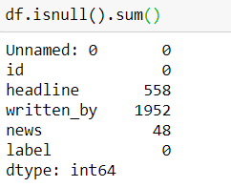
Exploratory data analysis process
From this function we find out the number of null values available in each columns that is the number of missing values available in each column both in train & test dataset.

Slide 7
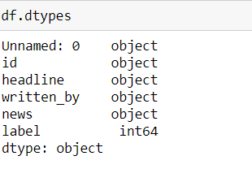
Exploratory data analysis process
By using “dtypes” we got to know the data types for each of the columns. Mostly data type are object in nature for training dataset and for test data type are classified under object type.

Slide 8
Model Dashboard
ML Algorithm Used | Predicted Score
PassiveAgressiveClassifier | 91.32%
HashingVectorizer | 89.22%
Naive Bayes classifier | 87.48%
To predict the result of this dataset above are classification models used for evaluations.
Out of all the machine learning models used I have selected Passive Aggressive classifier model for further evaluation of this dataset.

Slide 9
CONCLUSIONS
I have used various classifications methods and out of all algorithm, passive agressiveyields the best results.
I have also used cross validation technique to find the trade-off between bias& variance
These fake news detection can be used by media companies to filter and classify some keywords as fake news and set their own policy going forward for the customers and other shareholders.

